Slide 1
Building Applications Using Spring JDBC 5
FILE HANDLING IN SPRING BOOT

Slide 2
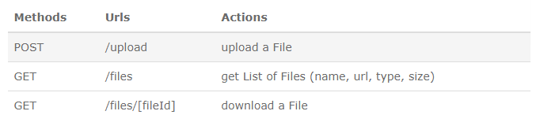
Spring Boot Rest APIs for uploading/downloading Files to Database

Slide 3







Technology

Slide 4
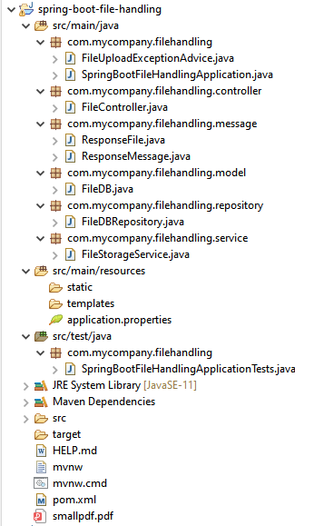
Project Structure

Slide 5
id: automatically generated as UUID
name: name of the file
type: mime type
data: array of bytes, map to a BLOB
Create Data Model

Slide 6
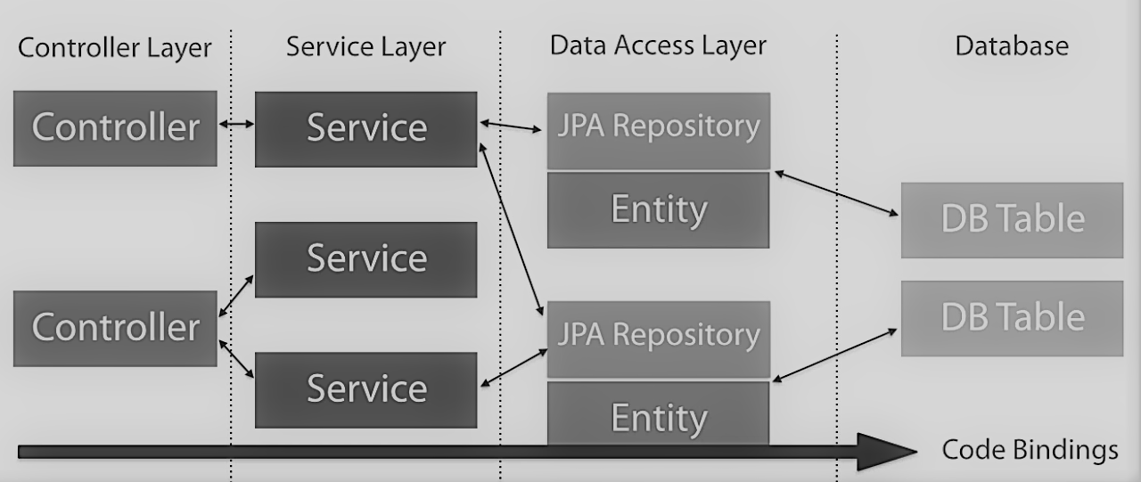
Repository Architectural Overview

Slide 7
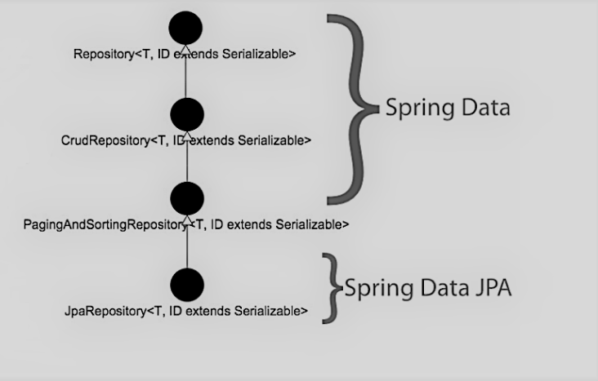
Spring Data and Data JPA Repositories

Slide 9
store(file): receives MultipartFile object, transforms it to a FileDB object and saves it to the Database
getFile(id): returns a FileDB object by provided Id
getAllFiles(): returns all stored files as list of FileDB objects
Create Service for File Storage

Slide 10
Define Response Information Classes
ResponseFile: contains name, url, type, size
ResponseMessage for notification/information message

Slide 11
– @Controller annotation is used to define a controller.
– @GetMapping and @PostMapping annotation is for mapping HTTP GET & POST requests onto specific handler methods:
POST /upload: uploadFile()
GET /files: getListFiles()
GET /files/[id]: getFile()
– We use @Autowired to inject implementation of FileStorageService bean to local variable.
Create Controller for upload & download Files to Database

Slide 12
Configure Spring Datasource, JPA, Hibernate
spring.datasource.url= jdbc:mysql://localhost:3306/filedb?useSSL=false
spring.datasource.username= root
spring.datasource.password= password
spring.jpa.properties.hibernate.dialect= org.hibernate.dialect.MySQL5InnoDBDialect
spring.jpa.show-sql=true
spring.jpa.properties.hibernate.format_sql=true
# Hibernate ddl auto (create, create-drop, validate, update)
spring.jpa.hibernate.ddl-auto= update
# Configure Multipart File for Servlet
spring.servlet.multipart.max-file-size=2MB
spring.servlet.multipart.max-request-size=2MB

Slide 14

Create Spring Boot Application
Summary
Upload multipart files
get files’ information with static folder
via Restful API

